Slide 1
Of the People, by the People, for the People?
Threats other than Government that must be protected

Slide 2
Historical document that has what relevance today?

Slide 3
November 1863
Four Score and seven years ago our fathers brought forth on this continent, a new nation, conceived in liberty, and dedicated to the proposition that all men are created equal.

Slide 4
Now we are engaged in a great civil war, testing whether that nation or any nation, so conceived and so dedicated, can long endure. We are met on a great battle-field of that war. We have come to dedicate a portion of that field, as a final resting place for those who gave their lives that that nation might live. It is altogether fitting and proper that we should do this.

Slide 5
But, in a larger sense, we can not dedicate – we can not consecrate – we can not hallow – this ground. The brave men, living and dead, who struggle here, have consecrated it, far above our poor power to add or detract. The world will little note, nor long remember what we say here, but it can never forget what they did here.

Slide 6
It is for us the living, rather, to be dedicated here to the unfinished work which they who fought have thus far so nobly advanced. It is rather for us to be here dedicated to the great task remaining before us – that from these honored dead we take increased devotion – that we here highly resolve that these dead shall not have died in vain -

Slide 7
That this nation, under God, shall have a new birth of freedom – and that government of the people, by the people, for the people, shall not perish from the earth.

Slide 8
Jump from 1791-1868
14th Amendment – 1868
Overruled Dred Scott decision
From this point on, it was legal for African Americans to be citizens of the US
What has happened during this 77 year span?

Slide 9
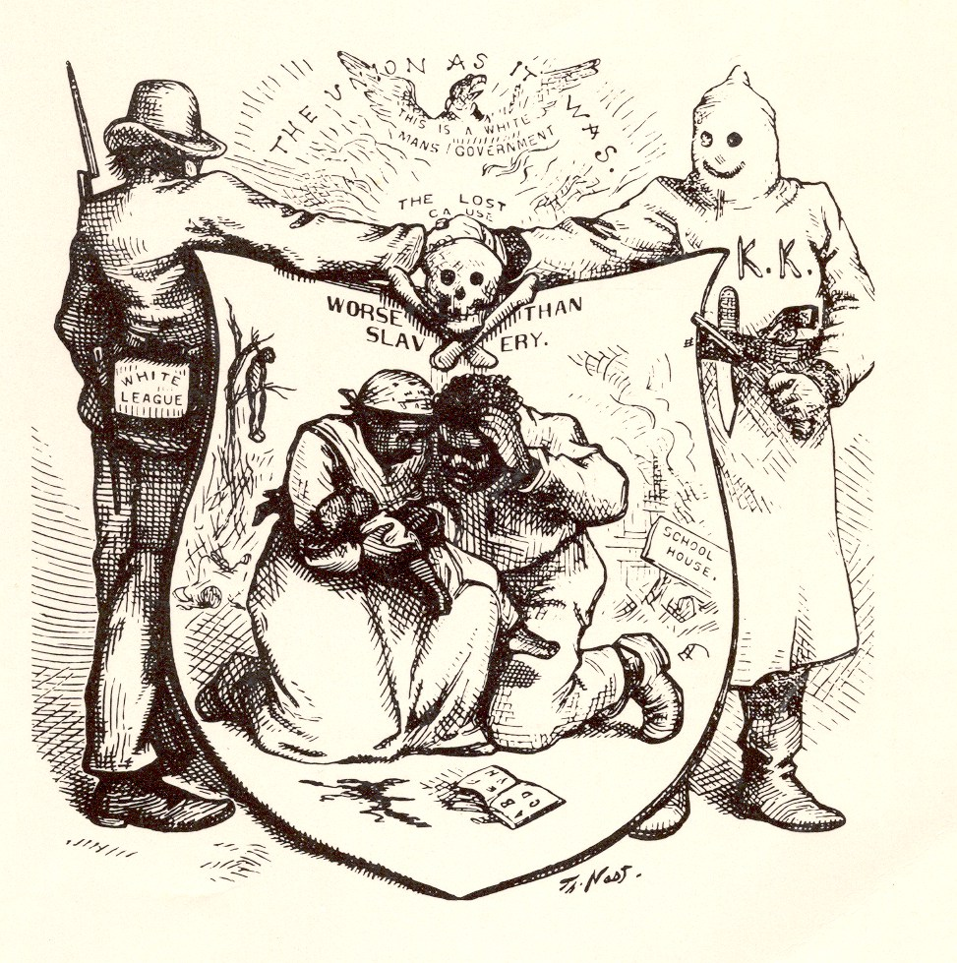

Slide 10
14th Amendment: Section 1
All persons born or naturalized in the United States, and subject to the jurisdiction thereof, are citizens of the United States and of the state wherein they reside. No state shall make or enforce any law which shall abridge the privileges or immunities of citizens of the United States; nor shall and State deprive any person of life, liberty, or property, without due process of law; nor deny to any person within its jurisdiction the equal protection of the laws.
-So this means justice is clear cut now?
-Black and white?
-it’s clear what is right and what is wrong?

Slide 11
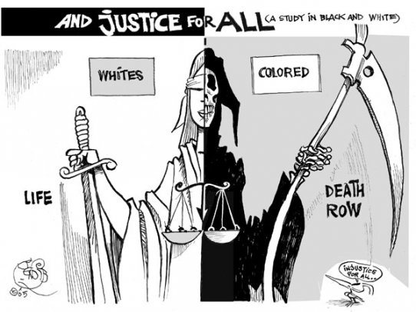

Slide 12
The Clansman
Written by Thomas Dixon Jr.
-1905
Movie made out of it
-”Birth of a Nation”
-1915

Slide 13
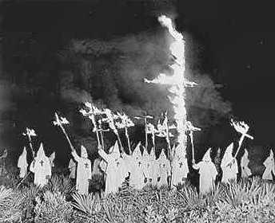
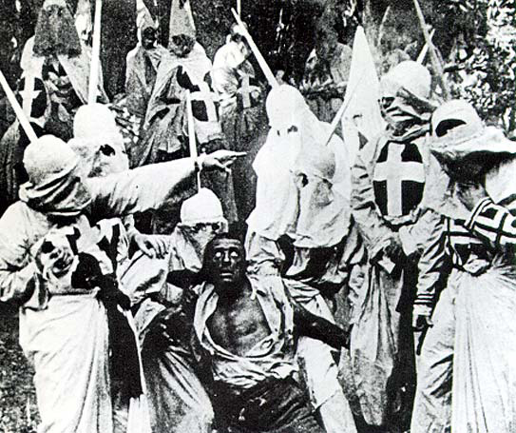
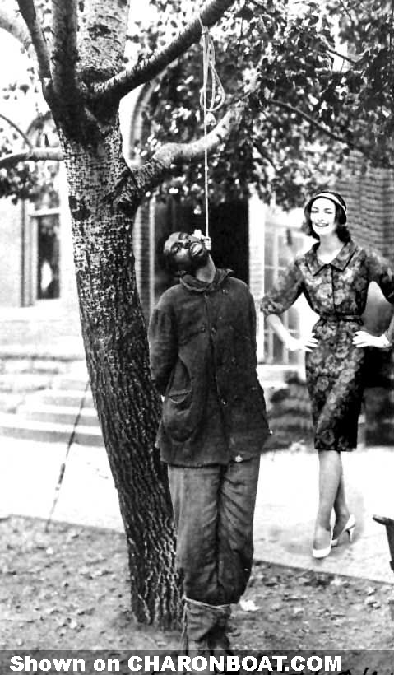
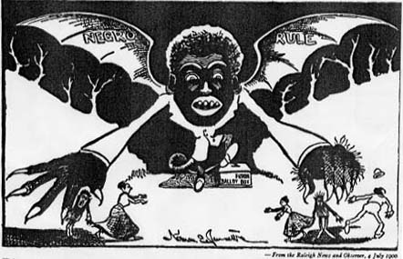
Early 1900’s

Slide 14
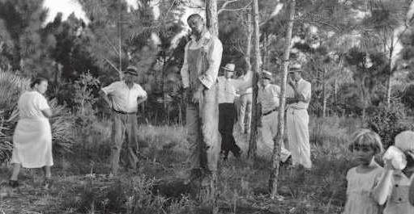
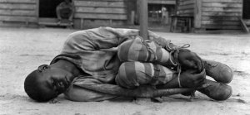
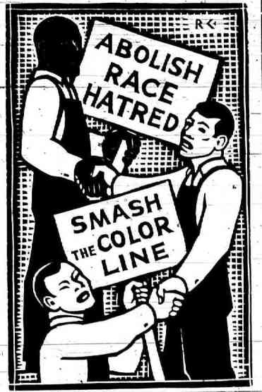
1930’s
Under laws enacted specifically to intimidate blacks, tens of thousands of African Americans were arbitrarily arrested, hit with outrageous fines, and charged for the costs of their own arrests. With no means to pay these ostensible “debts,” prisoners were sold as forced laborers to coal mines, lumber camps, brickyards, railroads, quarries and farm plantations.

Slide 15
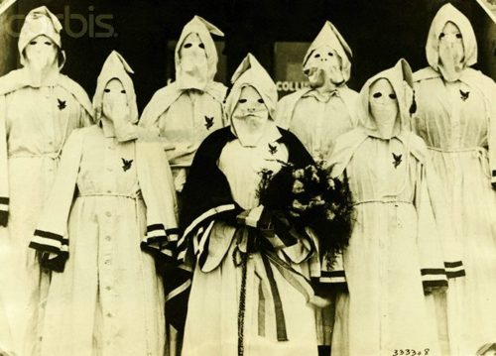
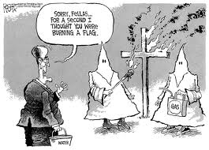
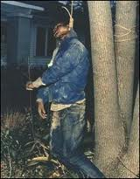
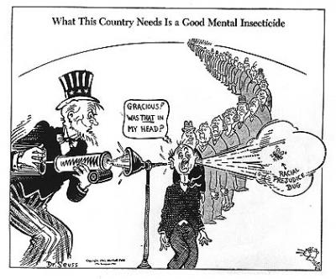
WKKK
1980’s

Slide 16
Freedom of Speech?

